Slide 1
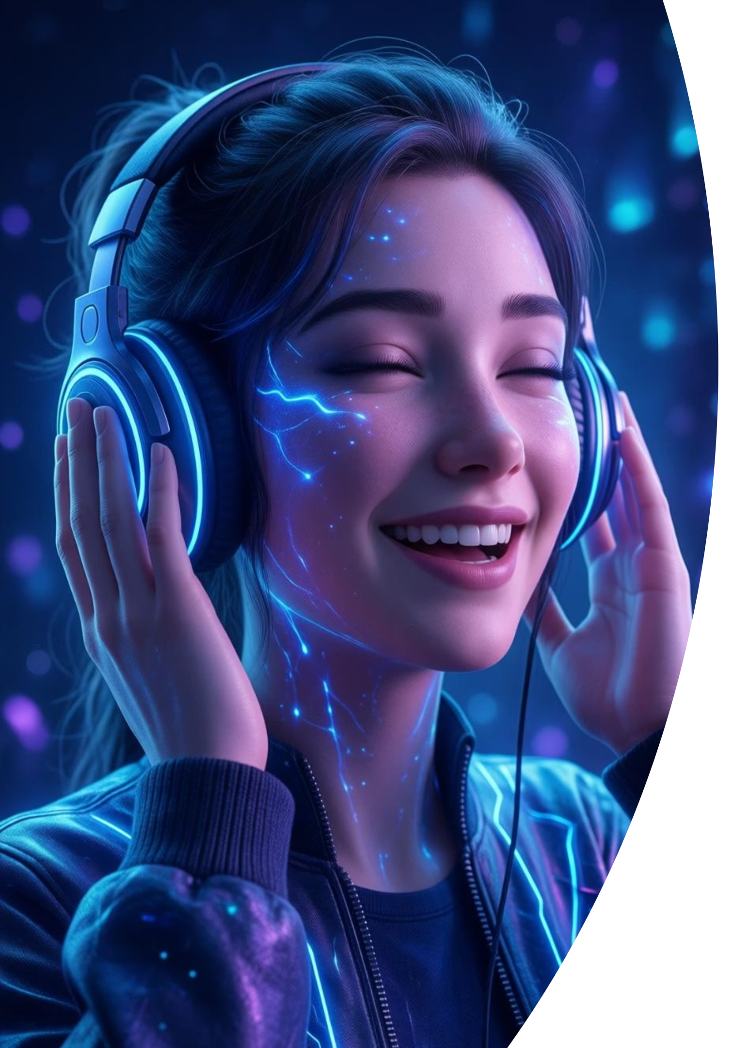
EmotiTune AI
Emotion Detection & Music Recommendation using AI

Slide 2
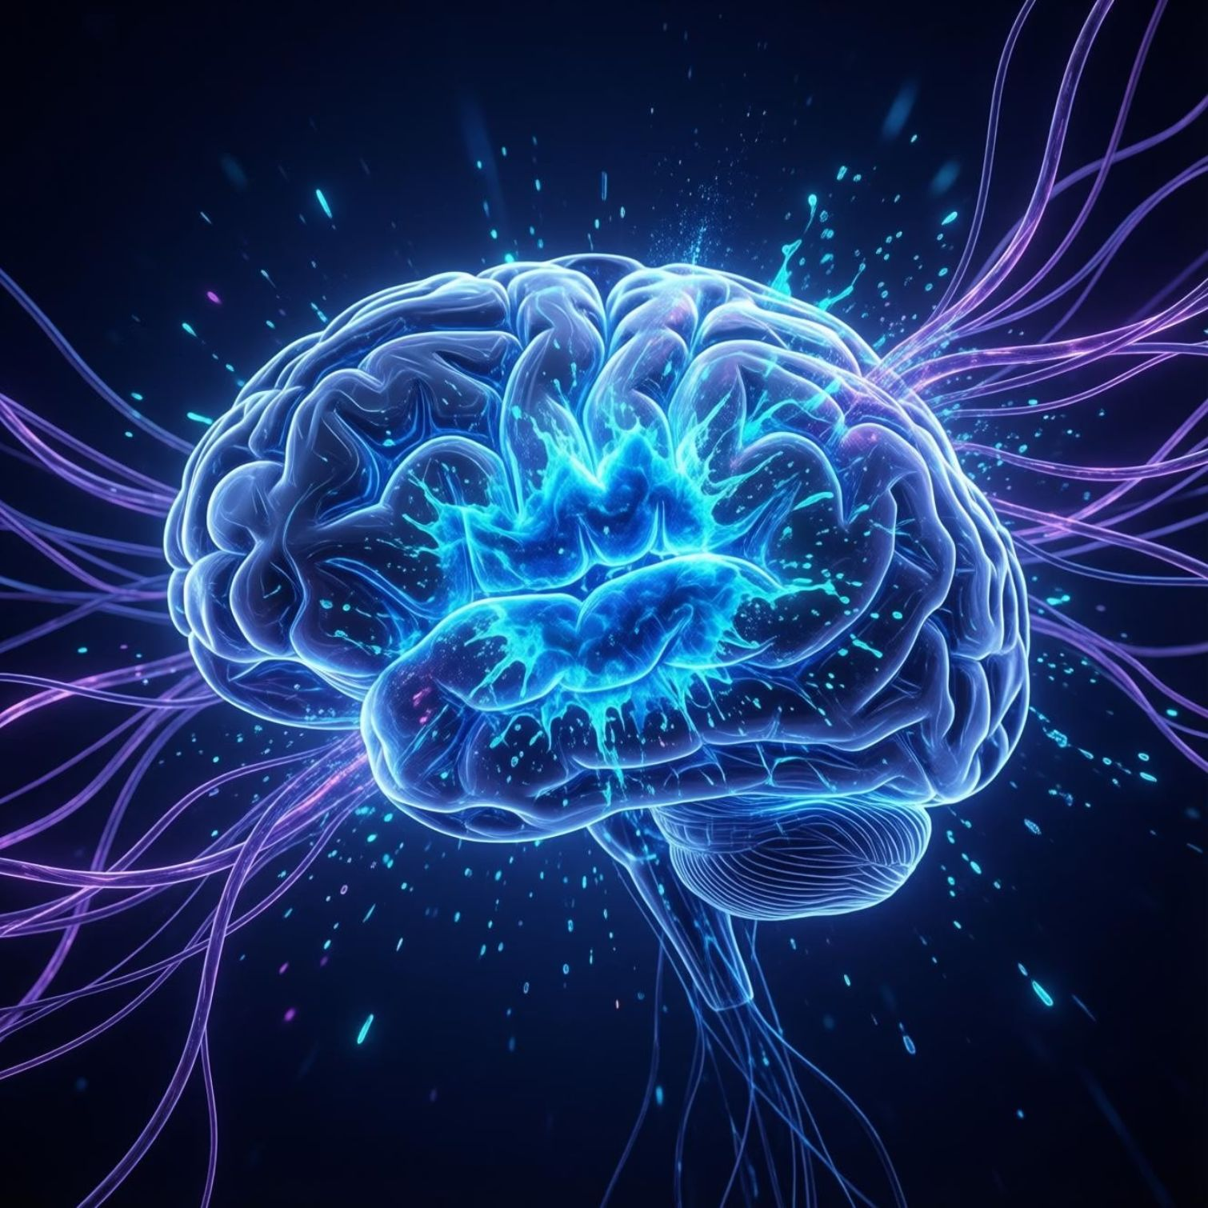
INTRODUCTION
Why Emotions Matter in Music
Traditional music recommendation systems rely on listening history and genre preferences, but they miss a crucial element—how you're feeling right now.
Emotion-aware AI systems represent the next evolution in personalised music experiences, understanding not just what you like, but what you need in the moment.

Slide 3





The Challenge We're Solving
Mood-Music Mismatch
Limited Intelligence
Users struggle to choose music that matches their current emotional state, leading to dissatisfaction
Existing systems lack emotional awareness and context, offering generic recommendations
Missing Connection
No seamless bridge between how users feel and what they hear, creating friction in the experience

Slide 4
PROJECT GOALS
Our Core Objectives
01
02
03
Emotion Detection
Intelligent Mapping
Smart Recommendations
Accurately identify human emotions from facial expressions or text input using advanced AI models
Create sophisticated emotion-to-music mapping that understands nuanced emotional states
Deliver personalised music suggestions that resonate with detected emotions in real-time

Slide 5


Expected Outcomes
1
Accurate Detection
AI-powered emotion recognition with high precision across multiple emotional states
2
Contextual Recommendations
Music suggestions tailored to emotional context, not just preferences
3
Real-Time Experience
Seamless, interactive system that responds instantly to user emotions

Slide 6
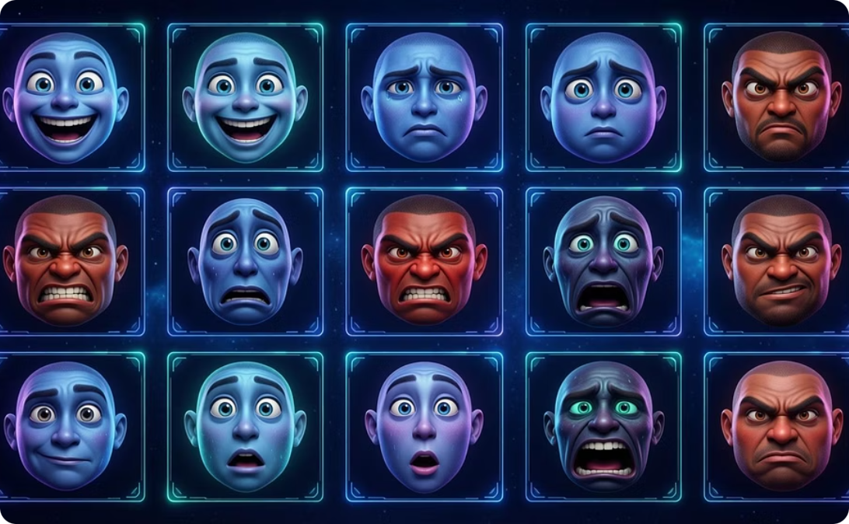
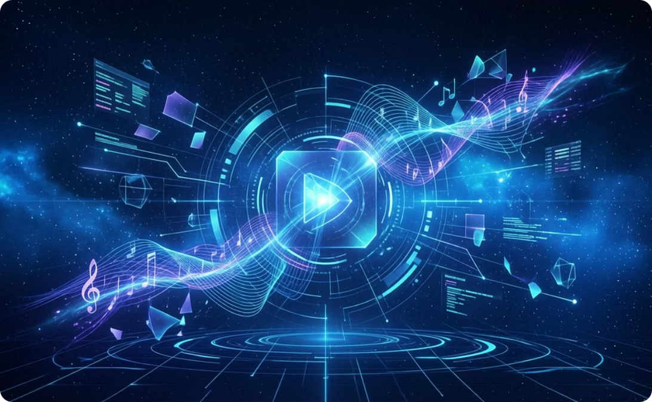
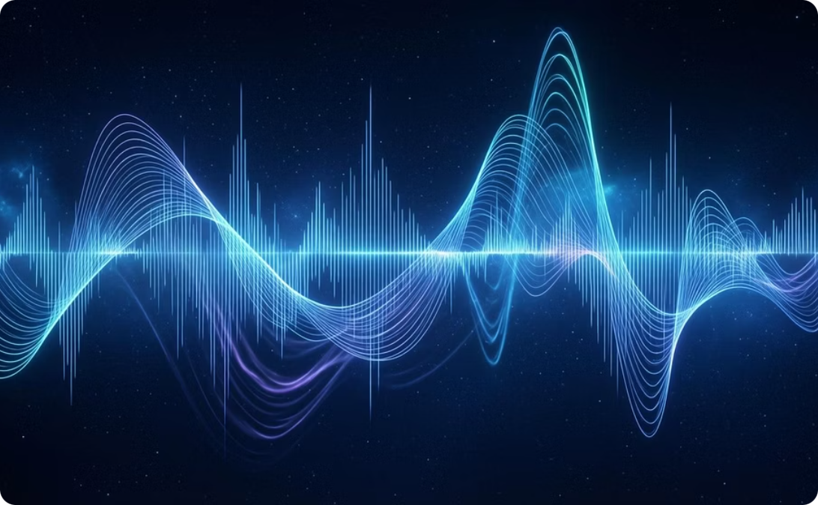
Datasets Powering EmotiSync
FER-2013
Million Song & Last.fm
RAVDESS (Optional)
Comprehensive Facial Emotion Recognition dataset with thousands of labelled expressions across seven emotion categories
Extensive music metadata and listening behaviour data providing rich features for recommendation algorithms
Audio-visual emotional speech and song database for enhanced multimodal emotion detection

Slide 7

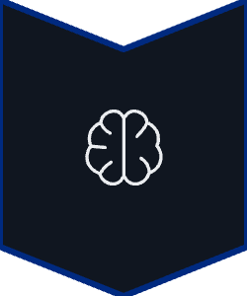



System Architecture
A streamlined pipeline transforming emotions into personalised music experiences
Input
Facial image or text
Emotion Detection
AI model analysis
Emotion Mapping
State classification
Music Recommendation
Track selection
Output
Personalised playlist

Slide 8
TECHNICAL COMPONENTS
Core System Modules
Data Collection & Preprocessing
1
Gathering and cleaning emotion and music datasets, preparing features for model training
2
Emotion Detection Engine
Deep learning models (CNN/Transformer) trained to recognise facial expressions and text sentiment
Music Feature Extraction
3
Analysing audio characteristics—tempo, valence, energy, mood tags—to build rich music profiles
4
Recommendation Algorithm
Intelligent matching system connecting emotional states to appropriate musical attributes
UI & Integration
5
User-friendly interface bringing all components together for seamless real-time interaction

Slide 9
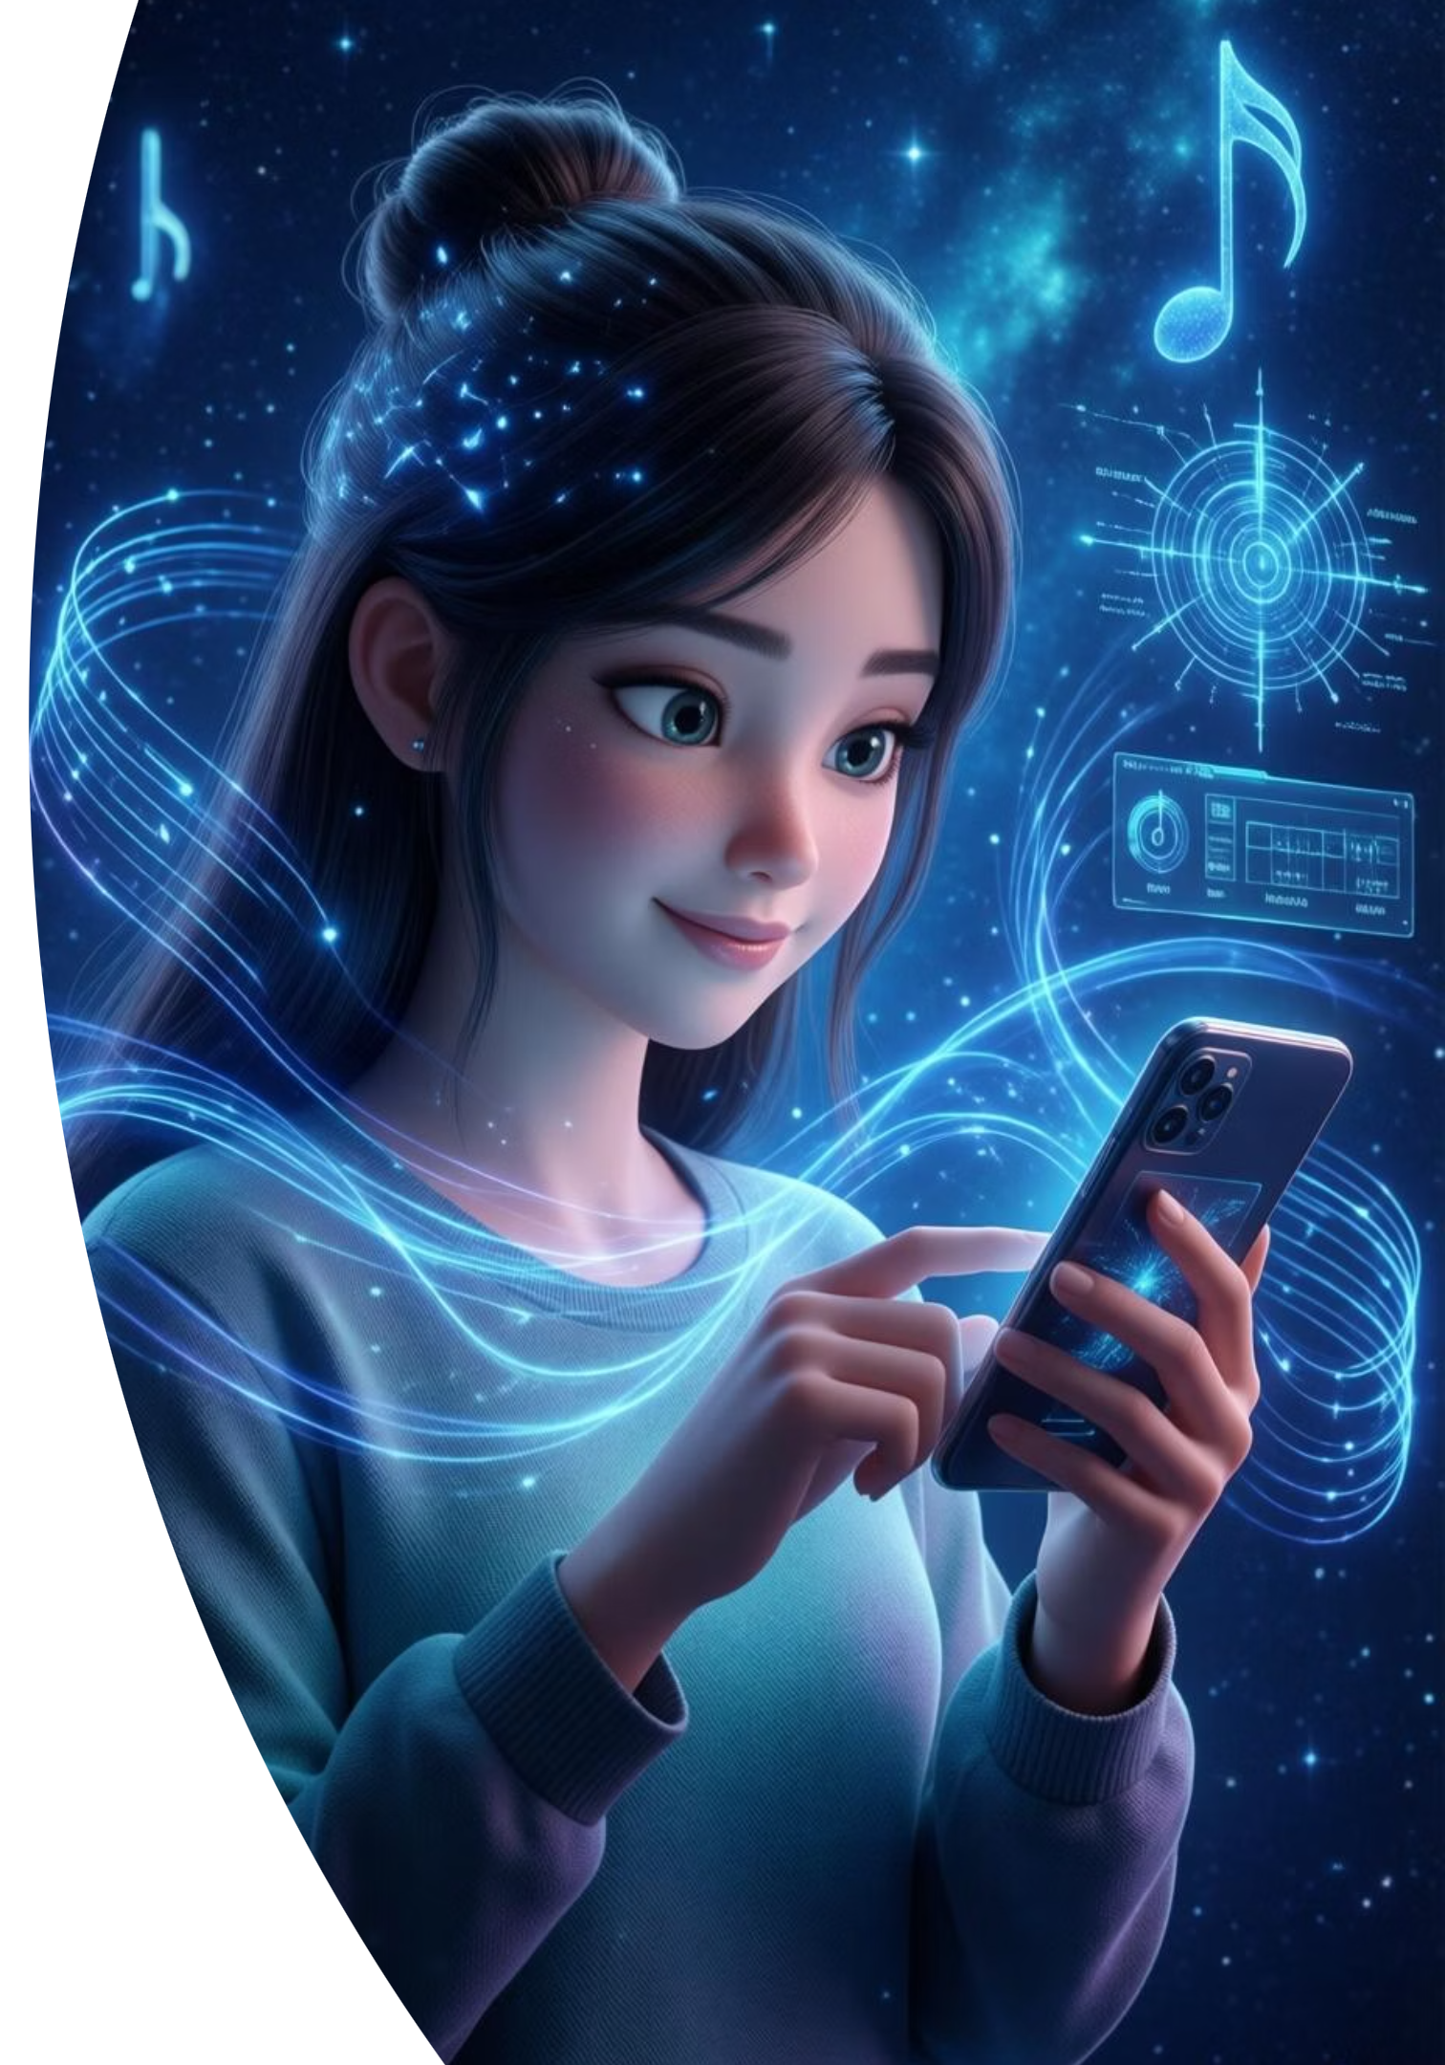

Real-World Applications
Mental Health Support
Therapeutic music recommendations for stress relief, anxiety management, and mood regulation in wellness apps
Music Streaming Platforms
Enhanced user engagement through emotion-aware features that differentiate platforms in competitive markets
Personalised Experiences
Adaptive interfaces in smart homes, vehicles, and wearables that respond to users' emotional states

Slide 10
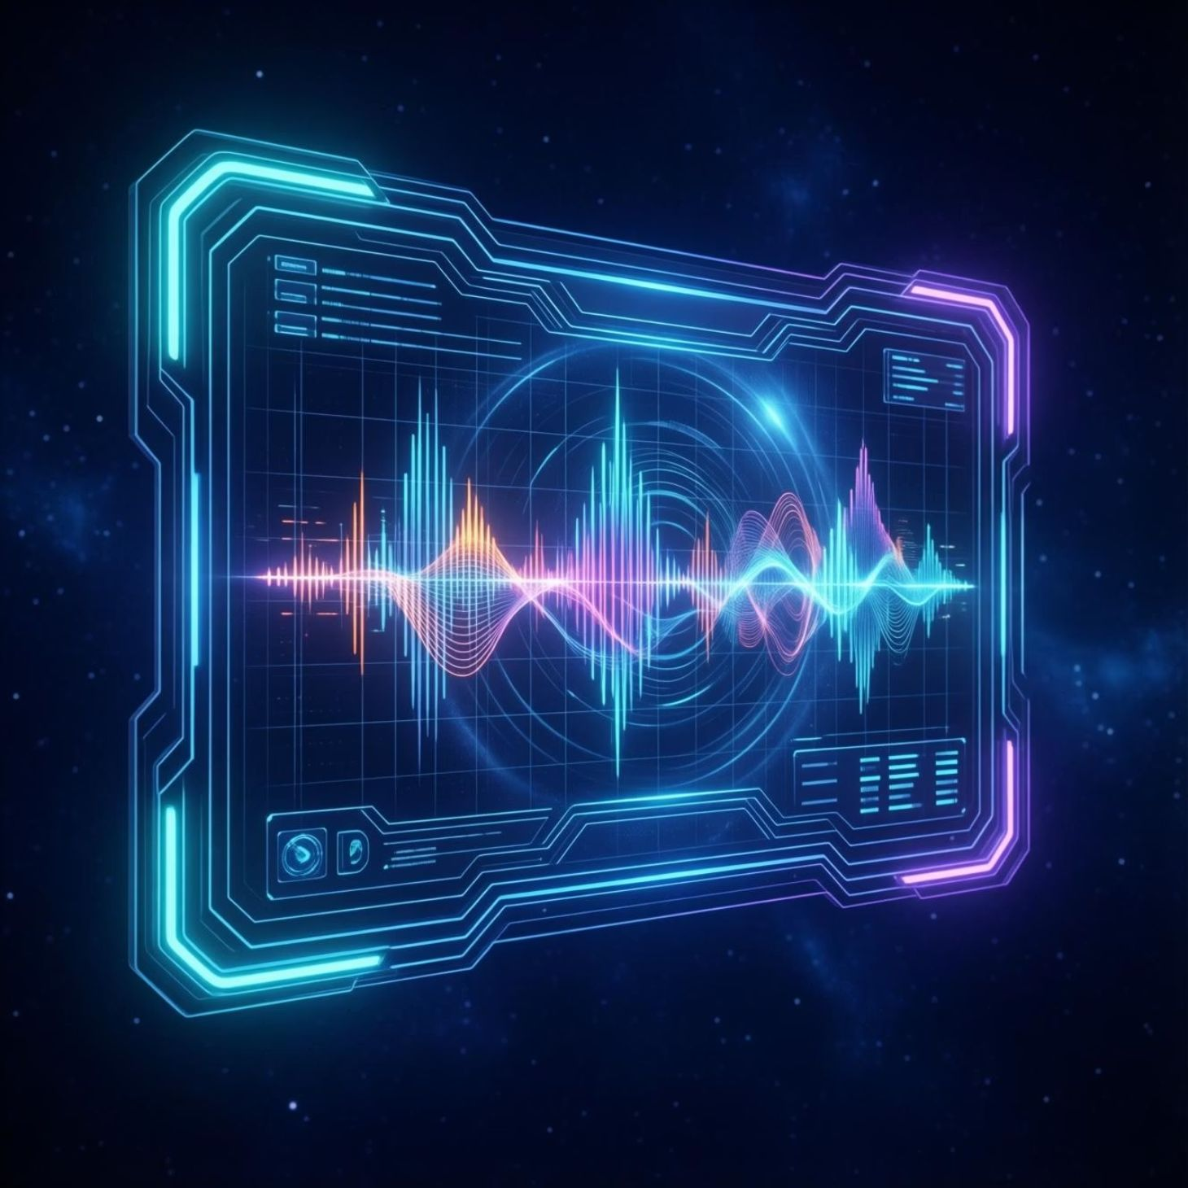

The Future of Music is Emotionally Intelligent
MoodMate bridges the gap between how we feel and what we hear, creating deeper connections through AI-powered understanding.
By combining cutting-edge emotion detection with intelligent music recommendation, we're not just playing songs—we're enhancing lives.
Ready to experience emotion-aware music? Connect with us for a live demo.

